Slide 1



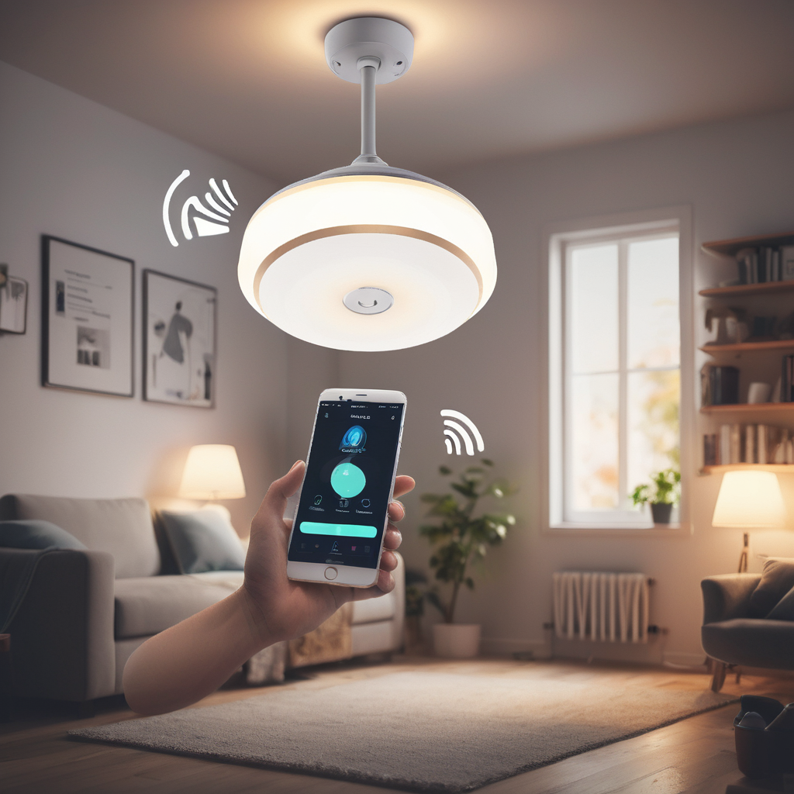
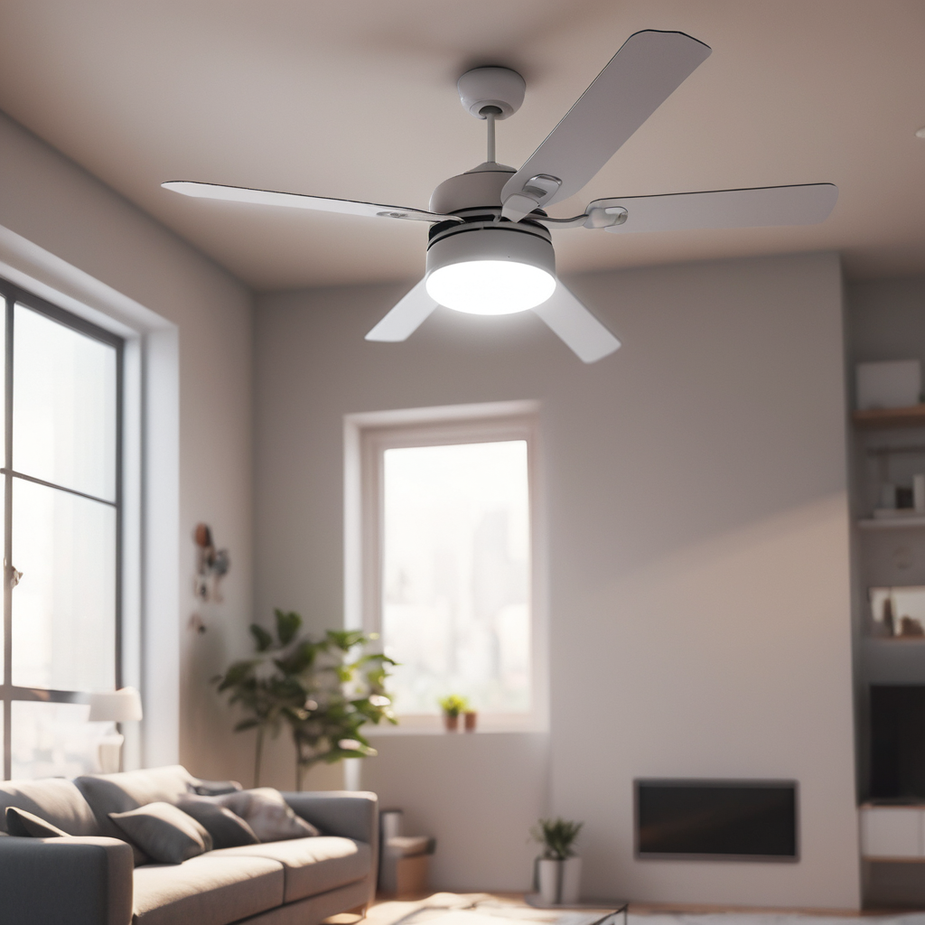
DEPARTMENT OF COMPUTER SCIENCE & ENGINEERING
SCHOOL OF COMPUTING
10214CS602 MINOR PROJECT -2
WINTER SEMESTER(2023-2024)
INITIAL REVIEW
“Voice Control Home Automation”
PRESENTED BY
SUPERVISED BY
1. RAJA RAJA CHOZHAN V K (VTU18963)(21UECS0514)
2. RAJA B (VTU18964)(21UECS0513)
3. NANDAGOPAL J (VTU19087)(21UECS0408)
Mr. S. GOPI, M.Tech

Slide 2
PROJECT TITLE JUSTIFICATION – VOICE CONTROL HOME AUTOMATION
Voice-Assisted: This title highlights the key feature of the project, which is voice control for operating home appliances. Voice commands provide a hands-free and intuitive interface, enhancing accessibility for all users, including elderly and disabled individuals.
Smart Home Automation System: The term "smart home automation" emphasizes the advanced technology used in the project, including Arduino microprocessor, Android smartphone integration, and wireless connectivity. It conveys the idea of automating household tasks for increased efficiency and convenience.
Accessibility and Convenience: By including "accessibility and convenience" in the title, the project's focus on catering to the needs of elderly and disabled individuals is highlighted. This aspect sets the project apart and emphasizes its potential impact on improving the quality of life for users with special needs.
Intuitive Interface: The term "Intuitive Interface" highlights the user-friendly nature of the project. Through voice commands, users can interact with their home environment in a natural and straightforward manner, without the need for complex manual controls or interfaces.

Slide 3
OBJECTIVE & SCOPE OF THE PROJECT
Objective:
The objective of the project is to design and implement a voice-controlled home automation system that enhances accessibility, efficiency, and energy-saving capabilities for users.
This system aims to provide a convenient and intuitive interface for controlling household appliances through voice commands, thereby catering to the needs of elderly, disabled, and tech-savvy individuals alike. The project seeks to leverage Arduino microprocessor technology, coupled with Android smartphone integration and wireless communication, to create a cost-effective and scalable solution for modern homes.
Scope:
Voice-Controlled Operation: The system will enable users to control various household appliances, including lights, doors, fans, and air conditioners, using voice commands via an Android smartphone or tablet.
Authentication Mechanism: The project will incorporate an authentication mechanism to ensure that only authorized users can access and control the home automation system, thereby enhancing security and privacy.
Wireless Connectivity: Communication between the Arduino microprocessor and the Android device will be established using Bluetooth technology, enabling seamless remote access and control of home appliances.
Energy Efficiency: The system will focus on optimizing energy usage and promoting sustainability by allowing users to schedule appliance operations, monitor energy consumption, and implement energy-saving strategies.
User Interface: An intuitive and user-friendly Android application will be developed to facilitate easy setup, configuration, and operation of the home automation system, catering to users of all technical backgrounds.
Scalability and Flexibility: The project will be designed to be scalable and adaptable to different home environments and user preferences, allowing for future expansion and integration with additional smart devices and functionalities.

Slide 4
TOOLS TO BE USED IN THE PROJECT
Arduino Microprocessor: Arduino boards will serve as the central processing unit for interfacing with sensors, actuators, and controlling household appliances based on voice commands.
Android Development Tools: Android Studio, along with Java or Kotlin programming language, will be used to develop the Android application that communicates with the Arduino board via Bluetooth and processes voice commands.
Bluetooth Module: A Bluetooth module compatible with Arduino, such as HC-05 or HC-06, will be used for establishing wireless communication between the Arduino board and the Android device.
Voice Recognition Software/Library: A voice recognition software or library, such as Google Speech Recognition API, PocketSphinx, or CMU Sphinx, will be integrated into the Android application to convert voice comma nds into actionable instructions.
Sensors and Actuators: Various sensors (e.g., motion sensors, temperature sensors) and actuators (e.g., relays, servo motors) compatible with Arduino will be used to detect environmental conditions and control household appliances accordingly.
Circuit Design Software: Software tools like Fritzing or Eagle will be used for designing circuit schematics and layouts to ensure proper connectivity and integration of components.
Version Control System: Utilizing version control systems like Git along with platforms like GitHub or GitLab will facilitate collaborative development, code management, and version tracking.
Documentation Tools: Documentation tools such as Markdown, LaTeX, or Microsoft Word will be used to create user manuals, technical documentation, and project reports to aid in project management and knowledge dissemination.

Slide 5
SOCIETAL IMPORTANCE OF THE PROJECT
Accessibility for Elderly and Disabled Individuals: By enabling control of household appliances through voice commands, the system enhances accessibility for elderly and disabled individuals who may have difficulty operating traditional switches or interfaces. This contributes to fostering independence and improving the quality of life for these segments of society.
Energy Efficiency and Environmental Sustainability: Through features like scheduling appliance operations and monitoring energy consumption, the system promotes energy efficiency and contributes to environmental sustainability. Reducing energy consumption not only leads to cost savings for users but also helps mitigate the impact of household energy use on the environment.
Time Saving and Convenience: Home automation systems streamline daily tasks and routines, saving users time and effort. This is beneficial for individuals balancing busy schedules, caregivers assisting elderly or disabled family members, and anyone seeking greater convenience in managing their home environment.
Technological Innovation and Economic Growth: Projects that leverage emerging technologies, such as voice recognition and wireless communication, drive innovation and contribute to economic growth. By developing and implementing novel solutions like voice-controlled home automation systems, the project stimulates technological advancement and creates opportunities for job creation and economic development in related industries.
Promotion of Independent Living: For elderly individuals who wish to age in place and maintain their independence, assistive technologies like the proposed home automation system provide valuable support. By facilitating independent living and reducing reliance on external assistance, the project empowers individuals to maintain their autonomy and dignity as they age.

Slide 6
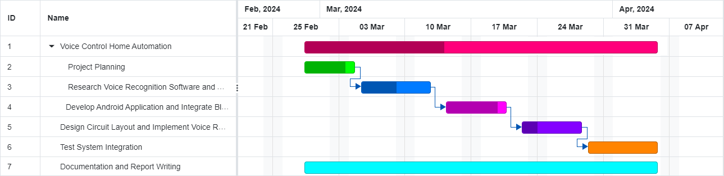
TIMELINE OF THE PROJECT
GANTT CHART

Slide 7

THANK YOU

